Slide 1


Statistics and Probability
Paweł Dąbrowski-Tumański
MiNI Lecture, Fall 2025

Slide 2



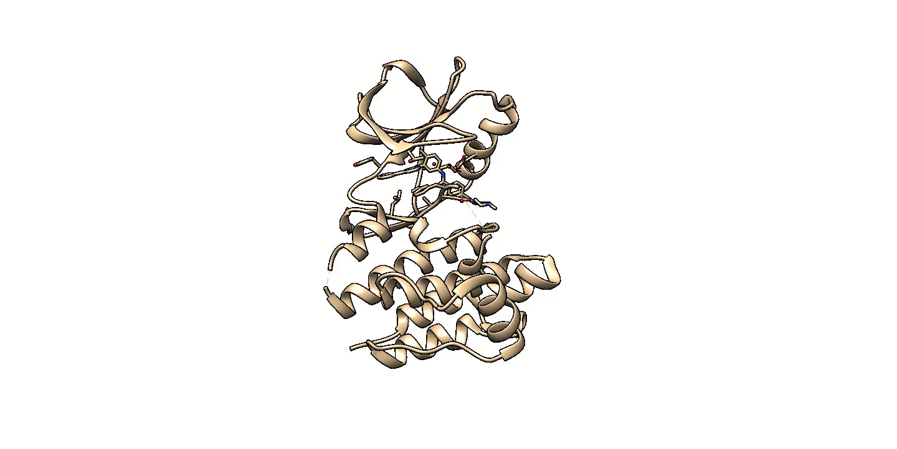





Creating anti-cancer drug
Drugs often work by binding to proteins, which changes the cell state
The cell state is measured by the type and amount of genes expressed.

Slide 3
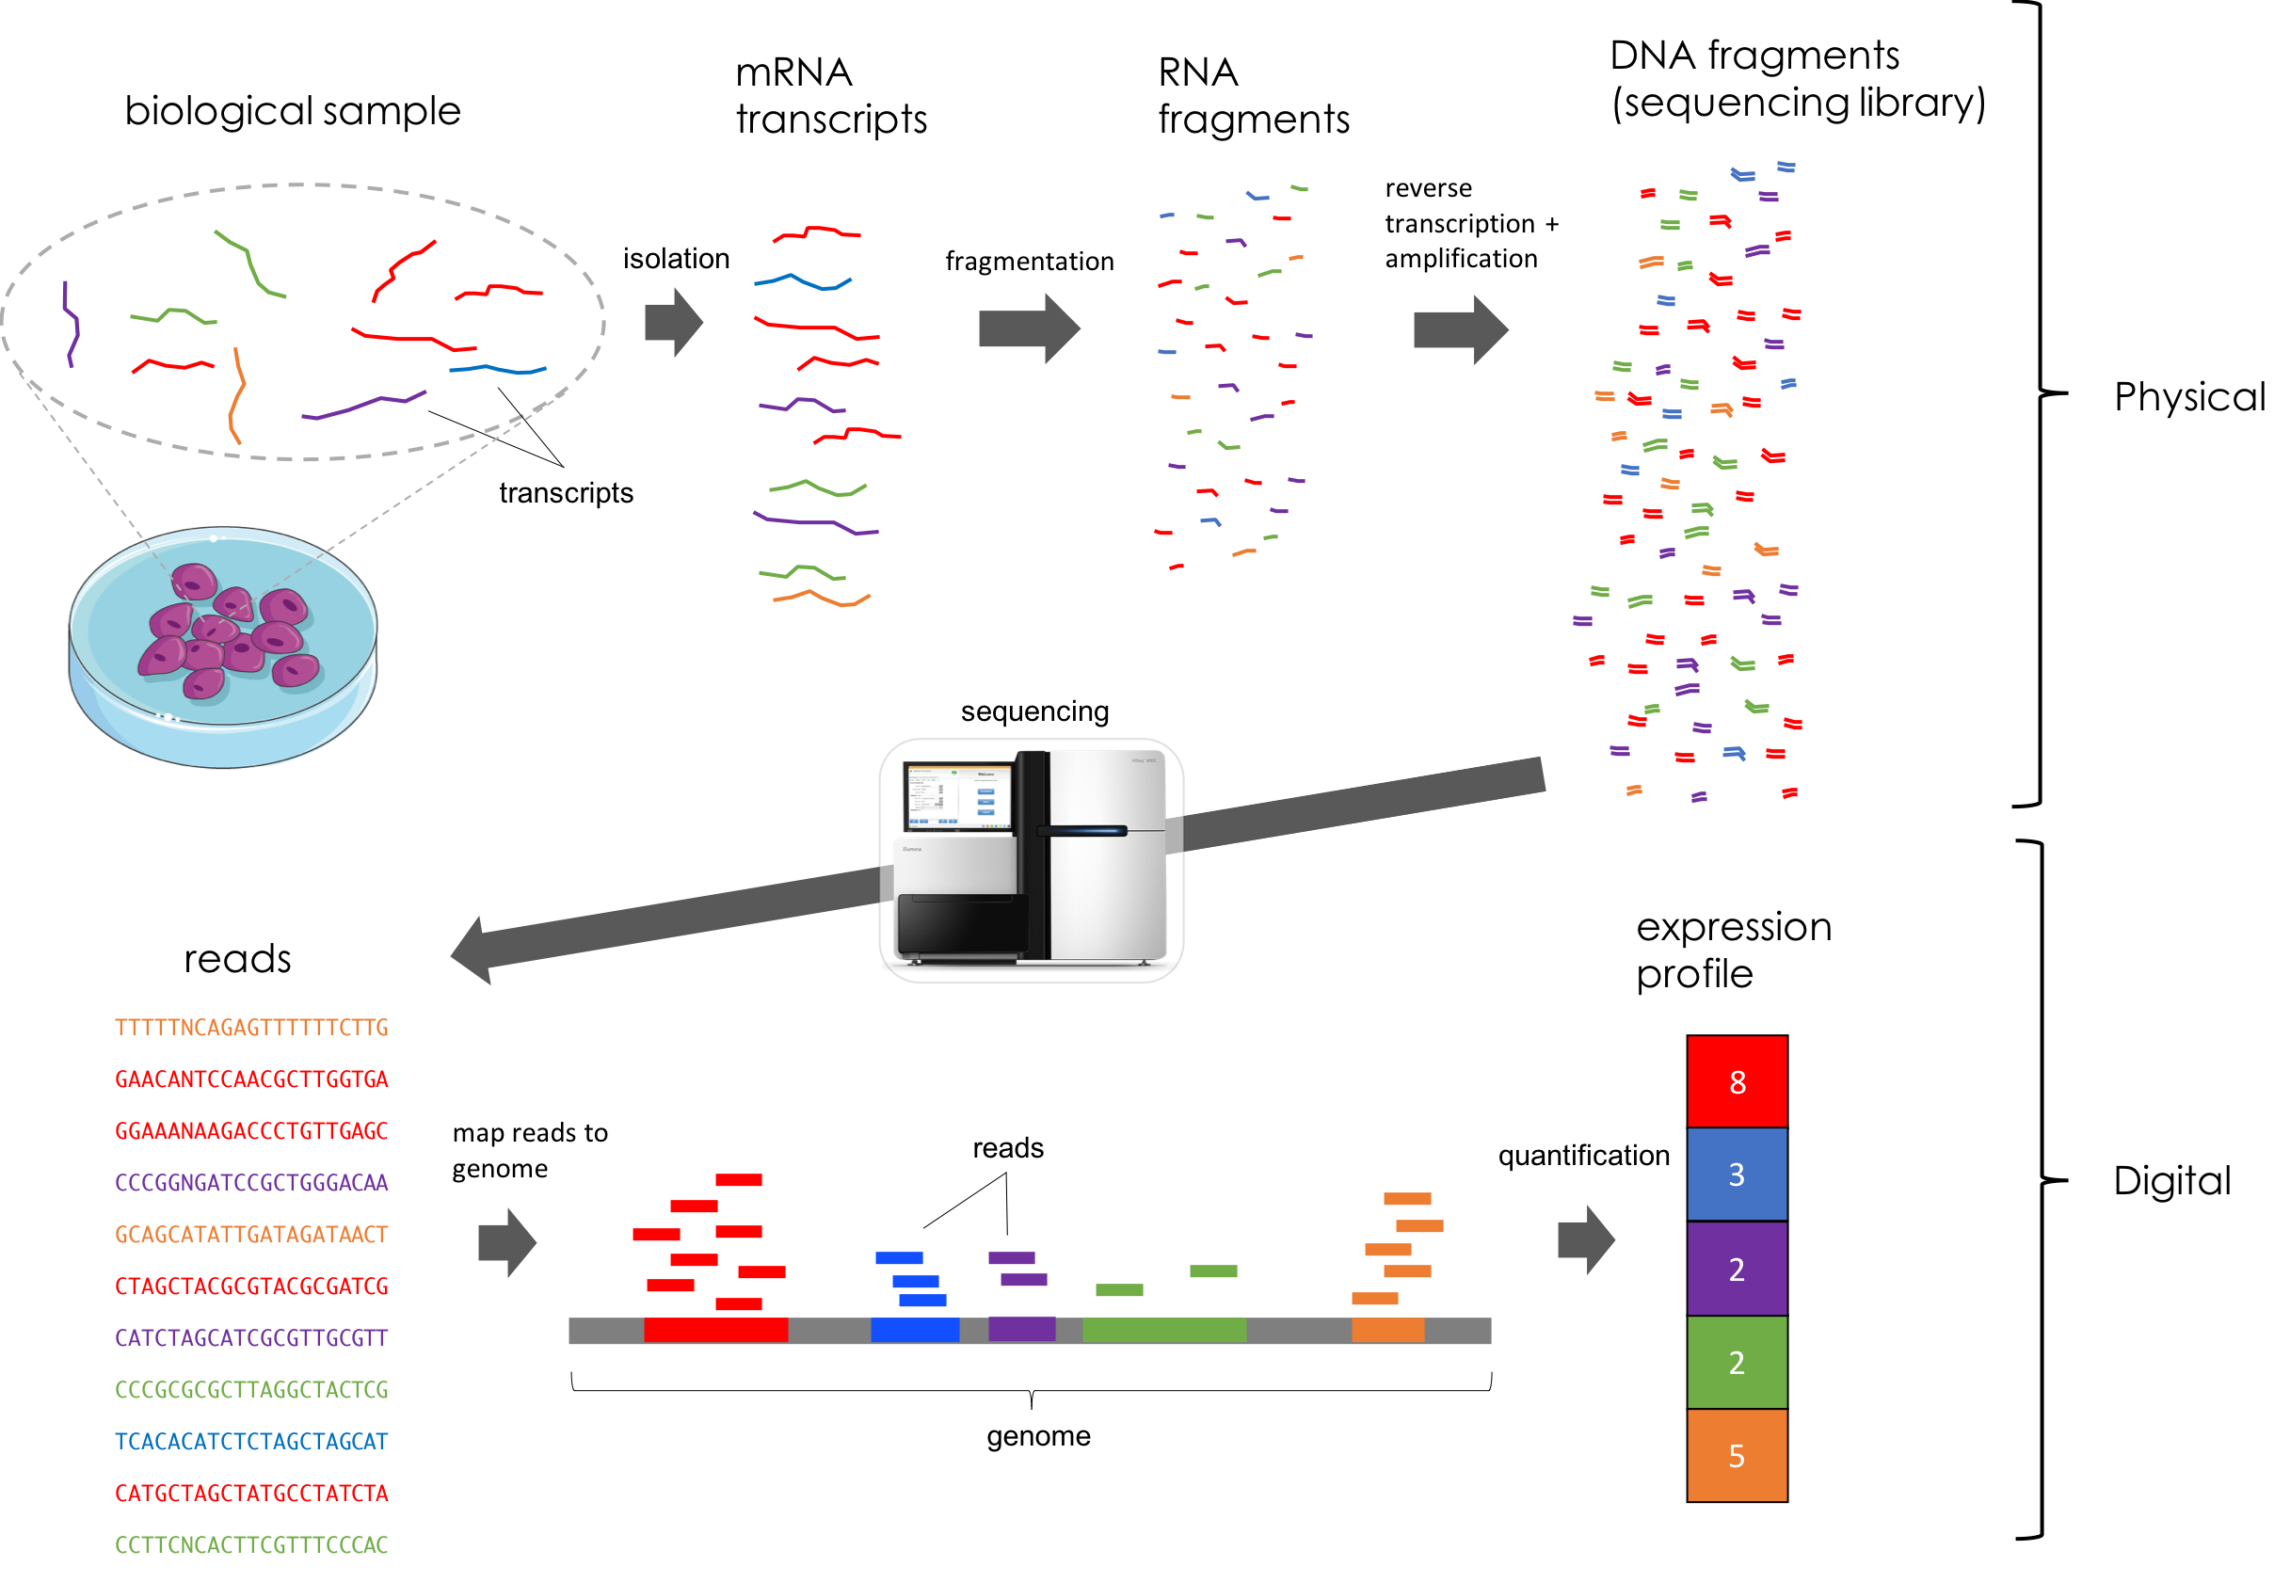
RNA-seq experiment
https://mbernste.github.io/posts/rna_seq_basics

Slide 4
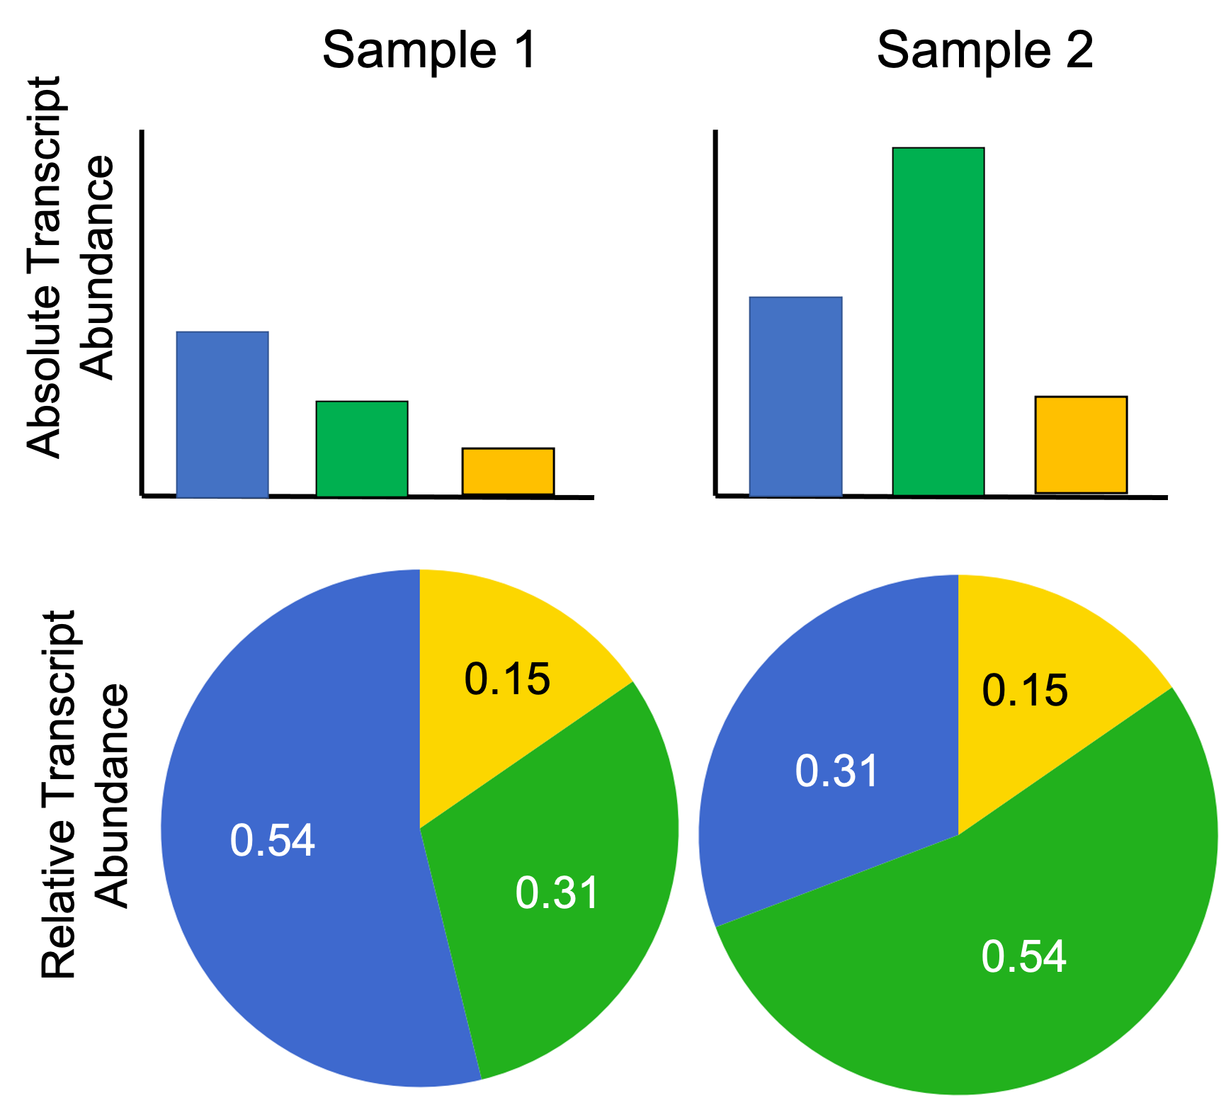
Which genes are important?
https://mbernste.github.io/posts/rna_seq_basics

Slide 5


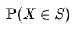
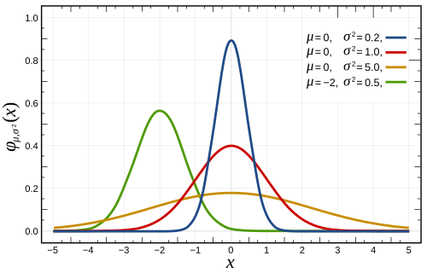
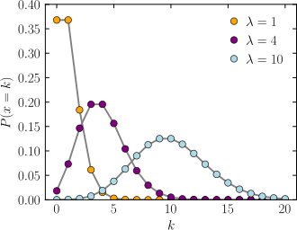
Random Variables
Mathematical definition of probability
Continuous random variable
(real values)
Discrete random variable
(counts)

Slide 6
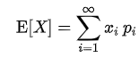
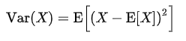
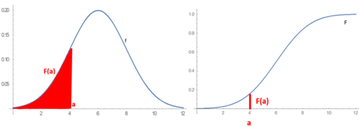
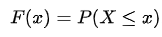
Mean, variance, PDF, CDF

Slide 7
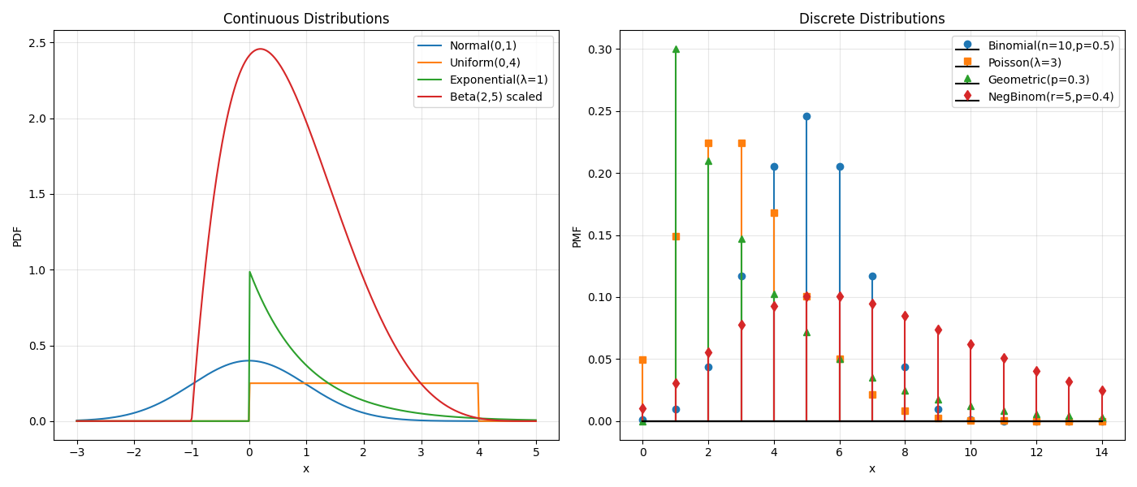
Most Common Distributions

Slide 8
Theoretical vs Experimental
One might expect the RNA-seq counts to follow Poisson distribution
Source of variation | Description | Effect on counts
Biological variability | True differences in expression between biological replicates (even within same condition). | Adds extra variance beyond Poisson.
Library preparation / sequencing depth | Each sample has slightly different total reads (library size), random PCR efficiency, transcript capture efficiency. | Multiplies expected counts by a random sample-specific factor.
Sampling bias | Some genes are more or less likely to be captured due to length, GC content, fragmentation bias. | Increases heterogeneity across samples.

Slide 9
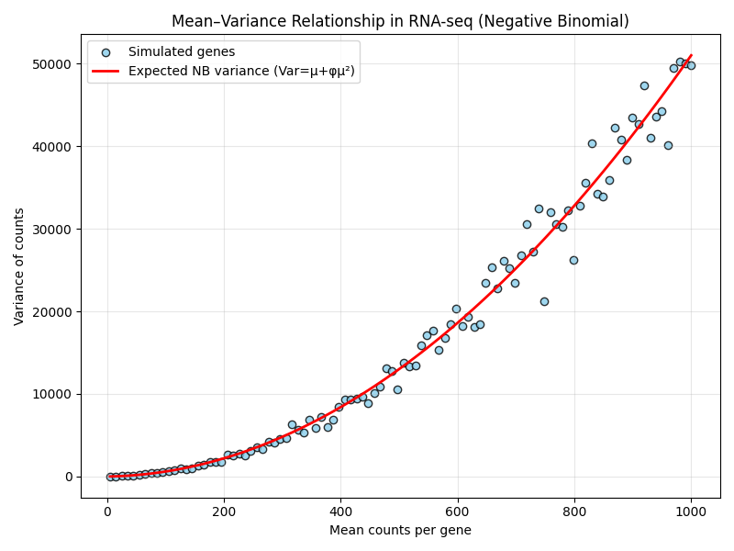
Gene counts in RNA-Seq
Counts in RNA-Seq follows Negative Binomial distribution

Slide 10
Distributions in Bioinformatics
Bulk RNA-seq counts → Negative Binomial
Single-cell UMI counts → NB or zero-inflated NB
Microarray / proteomics intensities → Log-normal
Variant allele counts → Binomial / Beta-Binomial
Methylation proportions → Beta or Beta-Binomial
Microbiome / compositional data → Multinomial / Dirichlet-multinomial
Survival times → Exponential / Weibull / Cox proportional hazards (semi-parametric).
Quality scores → Phred Q scores (log-odds of error): not normal

Slide 11
Wason’s 2-4-6 task
What is the pattern?

Slide 12

Hypothesis testing
Null hypothesis (H₀): There is no difference or effect. Example: “Gene X expression is the same in healthy and diseased tissues.”
Alternative hypothesis (H₁): There is a difference or effect. Example: “Gene X expression is different in healthy vs diseased tissues.”
Design experiment, which can distinguish between those two

Slide 13

Type I and II errors
Type I: False positive – rejecting H₀ when it’s true
Claiming Gene X is differentially expressed when it isn’t
Type II: False negative – failing to reject H₀ when it’s false
Failing to detect a true difference in Gene X expression

Slide 14
P-value
If H₀ is true, how probable is to observe data at least as extreme as ours?
Usually p < 0.05 taken as cutoff -> reject H₀.
Why this value?
P-value does not give the probability that H₀ is True!

Slide 15
P-Value pros and cons
“p < 0.05 = important”
Ignoring multiple testing
Not reporting effects of size

Slide 16
Context, size, replication
Effect size: How big is the difference in expression? (fold change, log2FC)
How statistically significant is the change?
Replication: Does it appear in independent datasets?

Slide 17
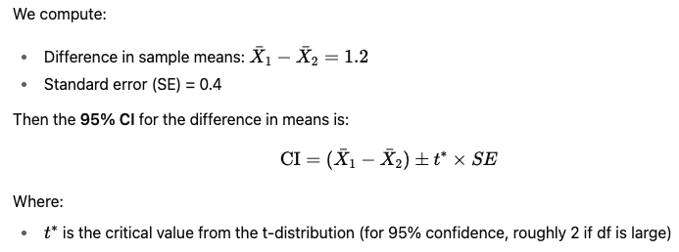
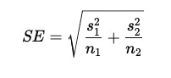
Confidence Intervals

Slide 18
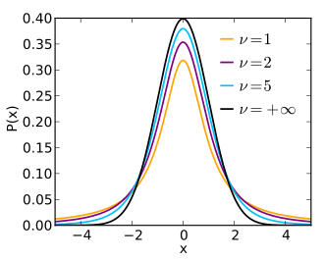
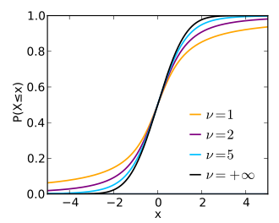
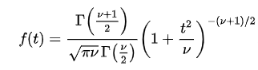
Student’s T-distribution

Slide 19
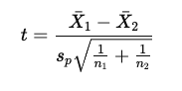
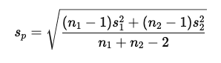
T-test
“Is the observed difference between two sample means likely due to random chance, or does it reflect a real difference?”
Compare it to the t-distribution with appropriate degrees of freedom (df) to get a p-value.

Slide 20
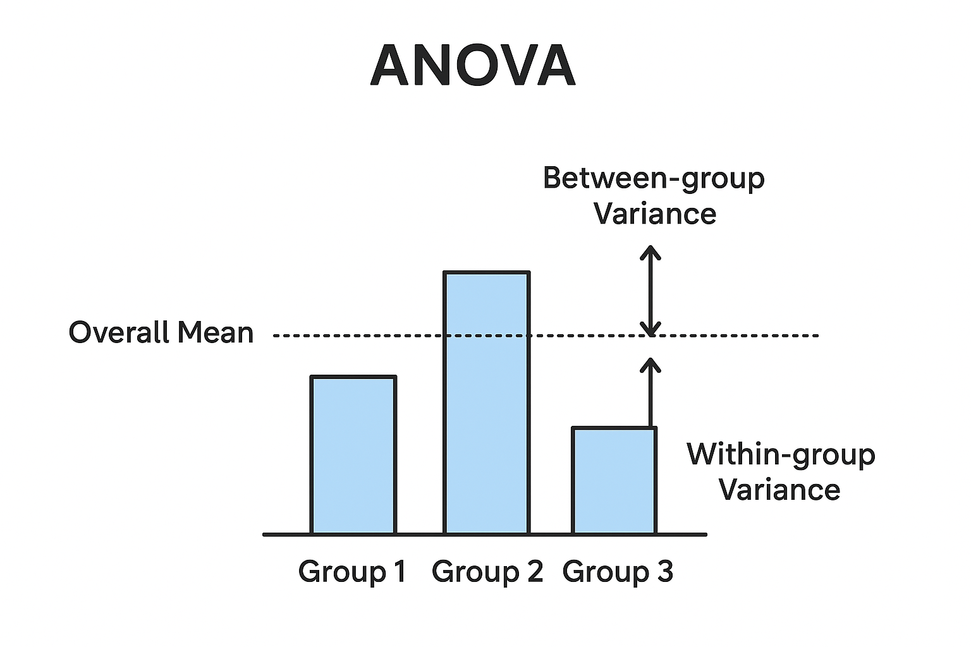
ANOVA
Three groups? Use analysis of variance
Is the variation between the groups bigger than the variation within the groups?

Slide 21
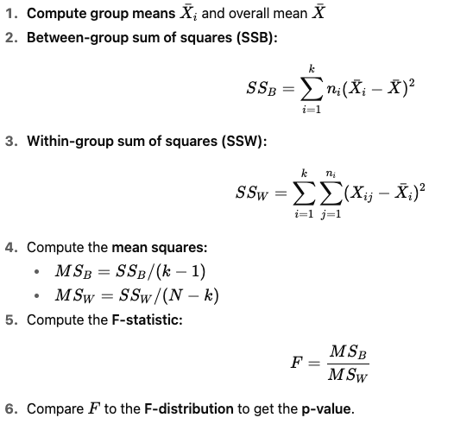
ANOVA

Slide 22
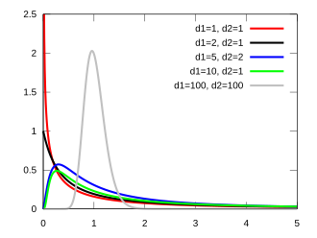
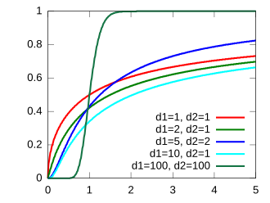
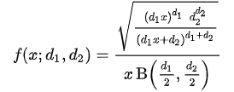
F-distribution

Slide 23

Multiple testing
If we test 10,000 genes, how many false positives do we expect at p < 0.05?
Suppose H₀ is true for all genes (no real differences).
At α = 0.05, each gene has a 5% chance of a false positive. Expected false positives = 10,000 × 0.05 = 500 genes!
In large-scale experiments (like RNA-seq), many “significant” genes can be false positives.

Slide 24

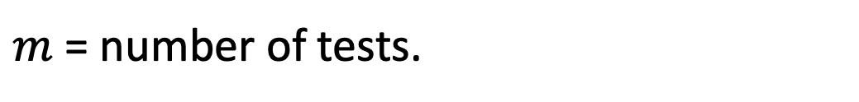
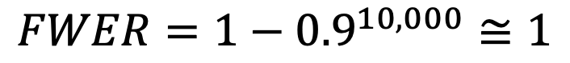
Family-wise Error Rate
$$FWER=P\left(≥1 false positives\right)=1−{(1−α)}^{m}$$
$m$ = number of tests.
At 10,000 tests with $α=0.05$
$$FWER=1−{0.9}^{10,000}≅1$$

Slide 25
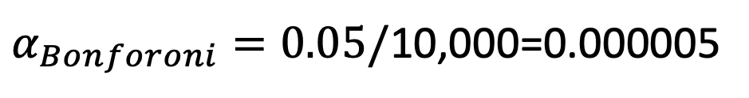
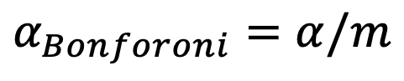
Bonferroni Correction
Scale significance cutoff
$$α_{Bonforoni}=α/m$$
At 10,000 tests with $α=0.05$
$α_{Bonforoni}=0.05/$10,000=0.000005
Too strict!

Slide 26

False Discovery Rate
Researchers are okay with some false positives if most discoveries are real.
$$FDR=E\left[\frac{False Positive}{Total Positive}\right]$$

Slide 27
Benjamini-Hochberg procedure
Sort p-values from smallest to largest: $p_{1}≤p_{2}≤...≤p_{m}$
Choose desired FDR level (e.g., q = 0.05)
Find largest $k$such that $p_{k}≤\frac{k}{m}q$
Reject H₀ for all p-values $≤ p_{k}$

Slide 28
Benjamini-Hochberg procedure
Rank | p-value | Adjusted (BH) p-value = p × (m/i)
1 | 0.001 | 0.001 × 5/1 = 0.005
2 | 0.02 | 0.02 × 5/2 = 0.05
3 | 0.03 | 0.03 × 5/3 = 0.05
4 | 0.04 | 0.04 × 5/4 = 0.05
5 | 0.2 | 0.2 × 5/5 = 0.2

Slide 29
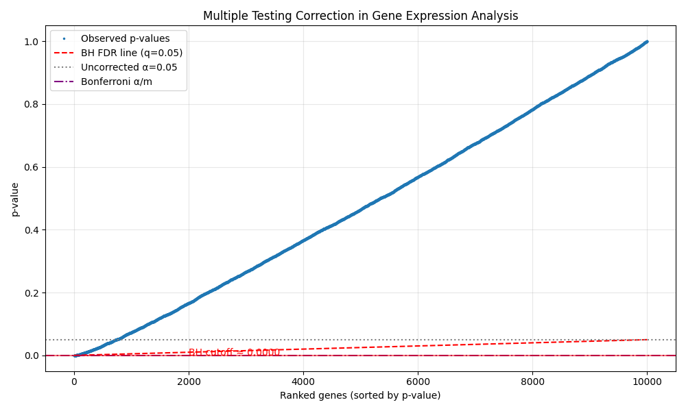
Benjamini-Hochberg example

Slide 30


Differential gene expression
Identify genes that show statistically significant differences in expression levels
Log₂ fold change of each gene (LFC): magnitude of change
P-value/adjusted p-value (FDR): significance

Slide 31
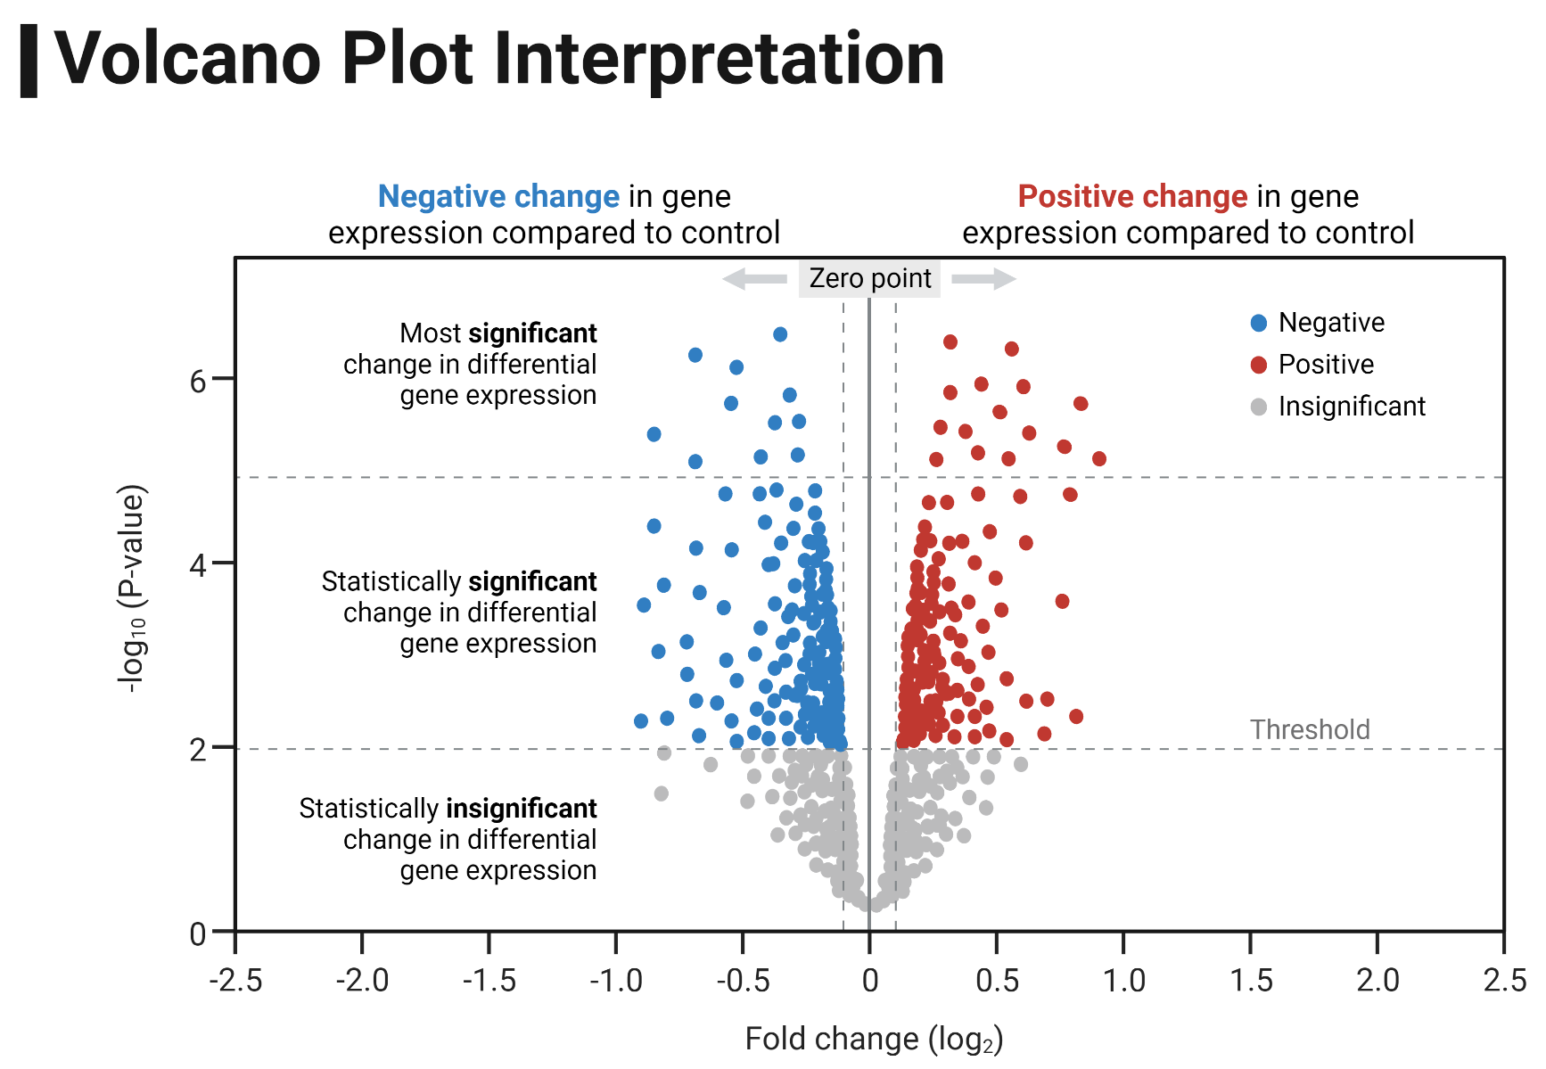
Data representation - Volcano

Slide 32
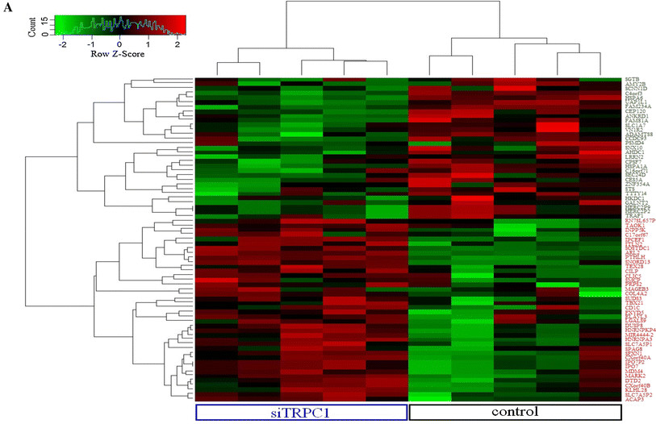
Data representation-Heatmap
Differential expression of store-operated calcium- and proliferation-related genes in hepatocellular carcinoma cells following TRPC1 ion channel silencing

Slide 33
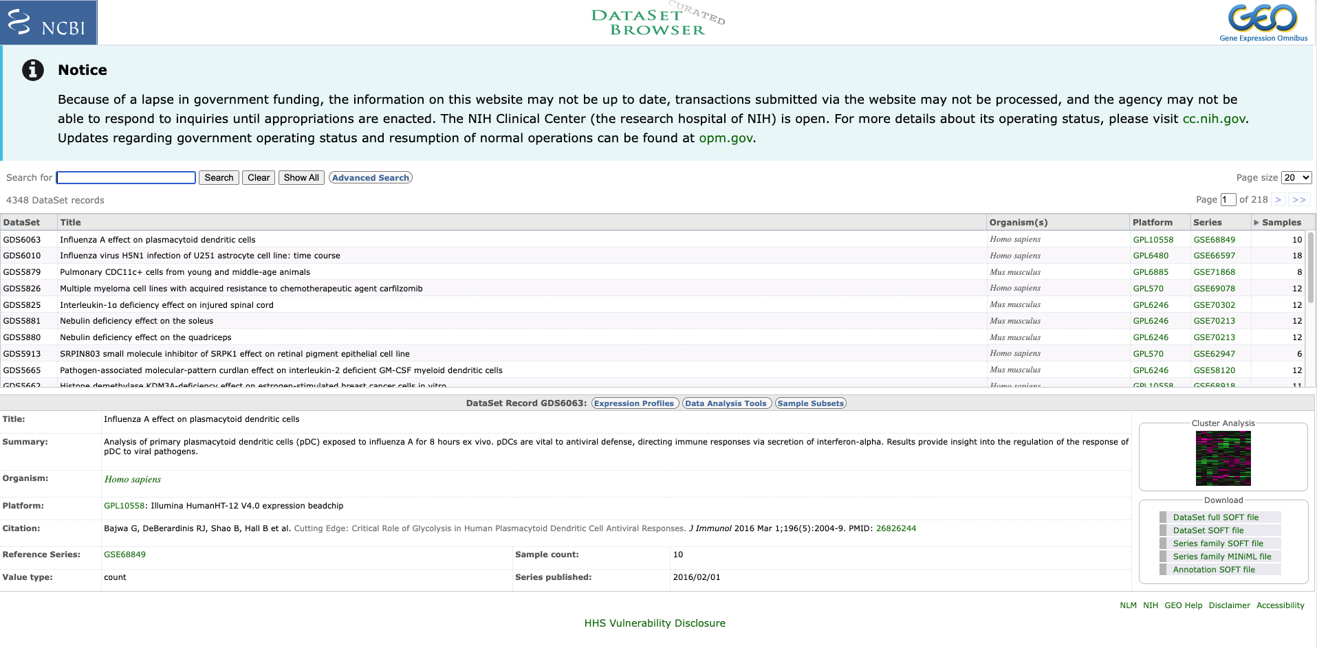
Gene Expression Omnibus

Slide 34
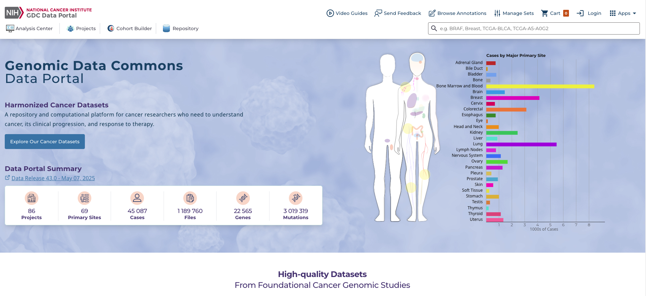
The Cancer Genome Atlas

Slide 35
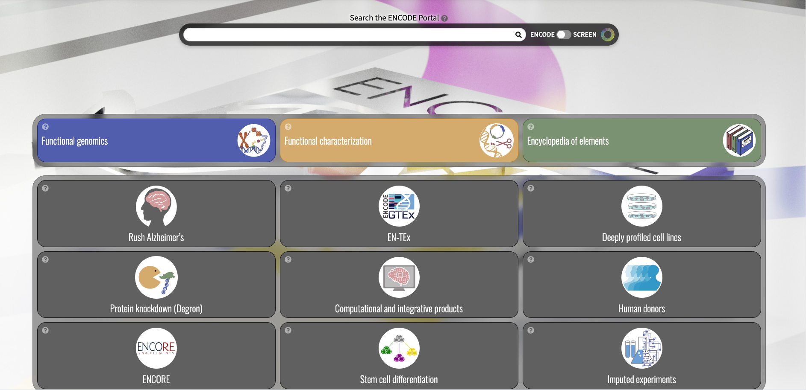
Encode

Slide 36
Planning experiments
Aspect | Sequencing Depth | Number of Replicates
What it improves | Precision of expression estimates for each sample | Power and reliability of differential expression results
Limiting factor | Cost per sample | Biological variability
When it matters most | Lowly expressed genes (need enough reads to quantify) | Detecting small fold changes reliably

Slide 37

Frequentist vs Bayesian
Given our RNA-seq data, what is the probability that Gene X is truly upregulated?
Concept | Frequentist | Bayesian
Parameters | Fixed but unknown | Random variable with a probability distribution
Data | Random (results of sampling) | Observed evidence used to update belief
Probability interpretation | Long-run frequency | Degree of belief
Question answered | “If H₀ is true, how likely is this data?” | “Given this data, how likely is H₀ (or parameter value)?”

Slide 38
Prior -> Likelihood -> Posterior
Prior (belief before seeing data) Encodes what we believe about the parameter before seeing the data.
Likelihood (data evidence) How likely the observed counts are, given a model of expression differences.
Posterior (updated belief) – Combines both: the probability distribution of the gene’s true effect size after seeing the data.

Slide 39
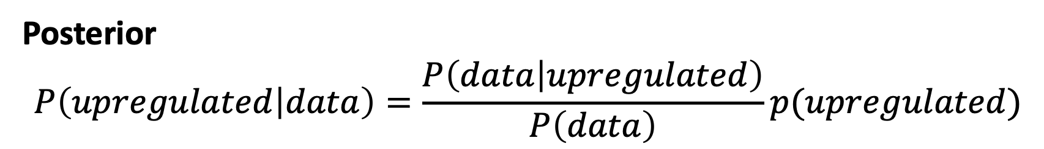
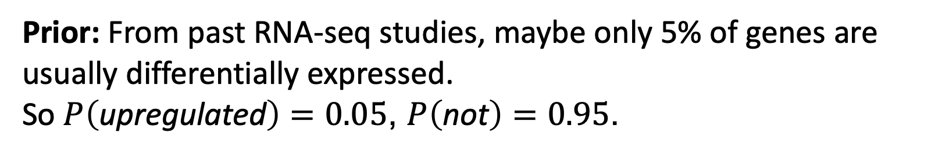
Prior -> Likelihood -> Posterior
Prior: From past RNA-seq studies, maybe only 5% of genes are usually differentially expressed.
So $P\left(\text{upregulated}\right)=0.05$, $P\left(\text{not}\right)=0.95$.
Likelihood: Given upregulation, you’d expect counts roughly doubled; given no effect, counts are similar. The observed data fit better with the “upregulated” model.
Posterior $$P\left(upregulated | data\right)=\frac{P\left(data | upregulated\right)}{P\left(data\right)}p(upregulated)$$

Slide 40
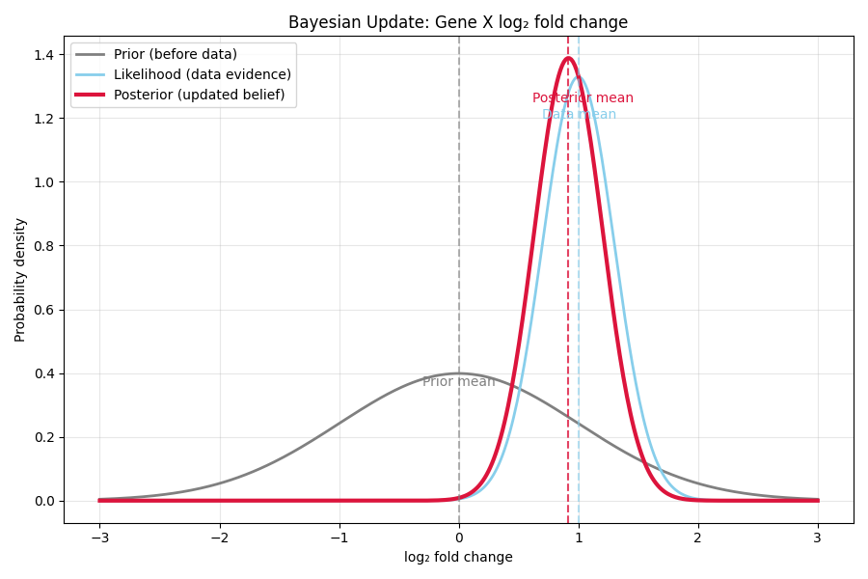
Example

Slide 41
Benefits
Integrating prior biological knowledge - Prior: most genes don’t change → regularizes noisy estimates.
Probabilistic interpretation - Instead of “significant or not,” we get posterior probabilities of differential expression.
Better handling of small-sample data - With few replicates, priors stabilize estimates (borrow strength across genes).
Transparent uncertainty quantification - The full posterior gives a confidence measure, not just a binary decision.

Slide 42

Bootstrapping
“How confident are we in our estimates of gene expression differences or model predictions?”
RNA-seq counts for Gene X in 6 samples: [50, 52, 48, 55, 60, 53]
Bootstrap by sampling 6 counts with replacement → compute mean → repeat 1000 times → get distribution of means → 95% CI.

Slide 43
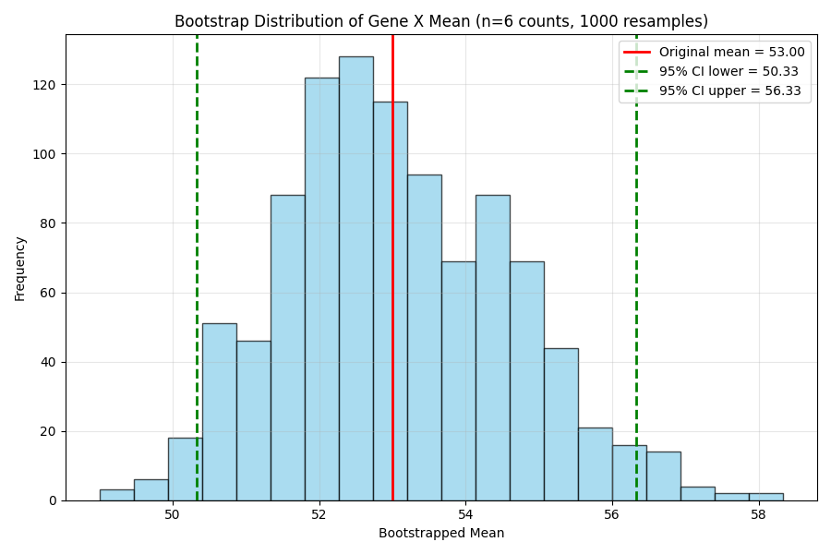
Bootstrapping
Initial counts = [50, 52, 48, 55, 60, 53]

Slide 44
Label reshufling
If there’s no difference between groups (null is true), then the labels “Control” and “Treatment” are interchangeable. So any reassignment of samples to groups is equally likely.

Slide 45
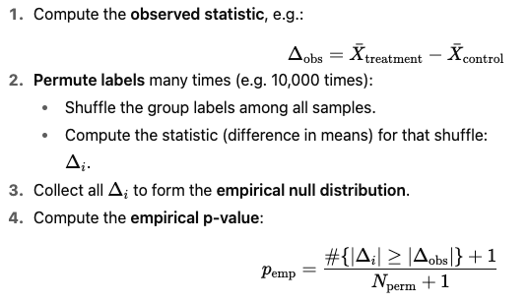
Label reshufling

Slide 46
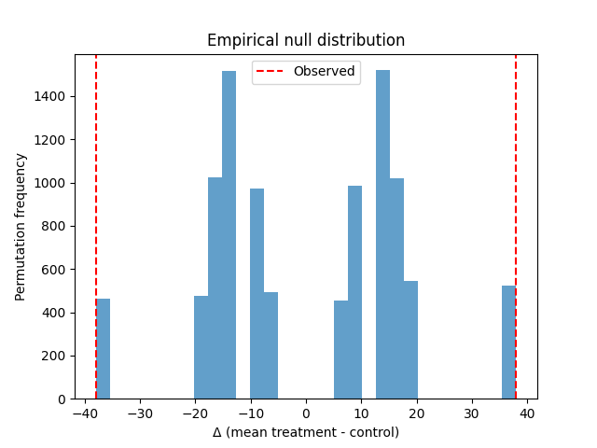
Label reshufling
empirical p = 0.0989
control = np.array([45, 50, 41])
treatment = np.array([83, 79, 88])
empirical p = 0.0989

Slide 47


Uncertainty in DL models
Neural net probabilities ≠ true confidence.
Softmax calibration
MonteCarlo Dropout
Bayesian Networks

Slide 48





Wrap-Up
The basics of probability theory are necessary to understand data
Differential Gene Expression as a tool for estimating treatement effect
Including prior knowledge can enhance results
A few databases with genes and protein sequences

